Slide 1
MINIMUM SPANNING TREE
INTRODUCTION
A minimum spanning tree is a subset of the edges of a connected, edged-weighted undirected graph that connects all the vertices together, without any cycles and with the minimum possible total edge weight.

Slide 2
How to Find the Minimum Spanning Tree?
They are two methods in algorithm we can use which are;
Prim’s Algorithm
Kruskal’s Algorithm

Slide 3
Prim’s Algorithm
Prim's algorithm begins with a single node and adds up adjacent nodes one by one by discovering all of the connected edges along the way.

Slide 4
Steps involved in Prim’s algorithms
Step 1: Choose any vertex as a starting vertex.
Step 2: Pick an edge connecting any tree vertex and fringe vertex (adjacent vertex to visited vertex) having the minimum edge weight.
Step 3: Add the selected edge to MST only if it doesn't form any closed cycle.
Step 4: Keep repeating steps 2 and 3 until the fringe vertices exist.
Step 5: End.

Slide 5
Kruskal’s Algorithm
Kruskal's approach sorts all the edges in ascending order of edge weights and only adds nodes to the tree if the chosen edge does not form a cycle. It also selects the edge with the lowest cost first and the edge with the highest cost last

Slide 6
The steps involved in Kruskal’s algorithm
Step 1: Sort all edges in increasing order of their edge weights.
Step 2: Pick the smallest edge.
Step 3: Check if the new edge creates a cycle or loop in a spanning tree.
Step 4: If it doesn’t form the cycle, then include that edge in MST. Otherwise, discard it.
Step 5: Repeat from step 2 until it includes |V| - 1 edges in MST.

Slide 7
Applications of Minimum Spanning Tree
The following are the applications of minimum spanning tree in data structures:
Telecommunication Network Building: A basic naive approach will be more expensive if we develop a telecommunication network for the entire city. Using the MST approach in data structures, we can design a communication system at a much lesser cost. The distinction between Naive and MST routing is illustrated in the diagram below.

Slide 8
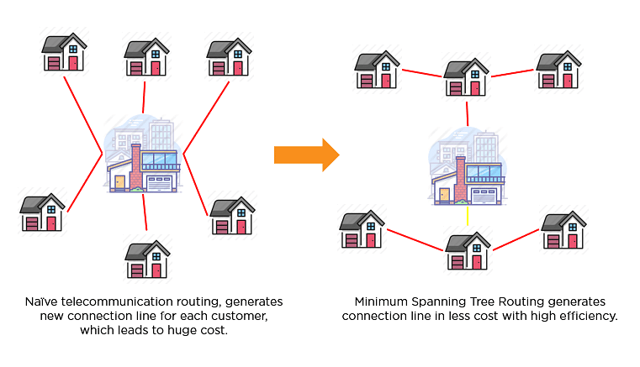

Slide 9
Constructing Highways or Railroads: The Minimum Spanning Tree (MST) technique is used globally for building roadways or railroads. The MST approach determines the best route between two cities depending on all potential routes. Essentially, the algorithm treats cities as vertices and roads connecting them as edges to produce a subtree that connects two cities with less cost.

